Slide 1
Credit Card Customer Segmentation

Slide 2
Section 1
- Problem definition, questions to be answered - Data background and contents - Univariate analysis - Bivariate analysis

Slide 3
Background and Context
AllLife Bank wants to focus on its credit card customer base in the next financial year. They have been advised by their marketing research team, that the penetration in the market can be improved.
Based on this input, the Marketing team proposes to run personalized campaigns to target new customers as well as upsell to existing customers. Another insight from the market research was that the customers perceive the support services of the back poorly.
Based on this, the Operations team wants to upgrade the service delivery model, to ensure that customers queries are resolved faster. Head of Marketing and Head of Delivery both decide to reach out to the Data Science team for help.

Slide 4
Objective of the project and Questions to be answered
Main Objective: To identify different segments in the existing customer based on their spending patterns as well as past interaction with the bank.
Key Questions
How many different segments of customers are there?
How are these segments different from each other?
What are your recommendations to the bank on how to better market to and service these customers?

Slide 5
Description of the data
Data is of various customers of a bank with their credit limit, the total number of credit cards the customer has, and different channels through which customer has contacted the bank for any queries, different channels include visiting the bank, online and through a call.
Customer key - Identifier for the customer
Average Credit Limit - Average credit limit across all the credit cards
Total credit cards - Total number of credit cards
Total visits bank - Total number of bank visits
Total visits online - total number of online visits
Total calls made - Total number of calls made by the customer

Slide 6
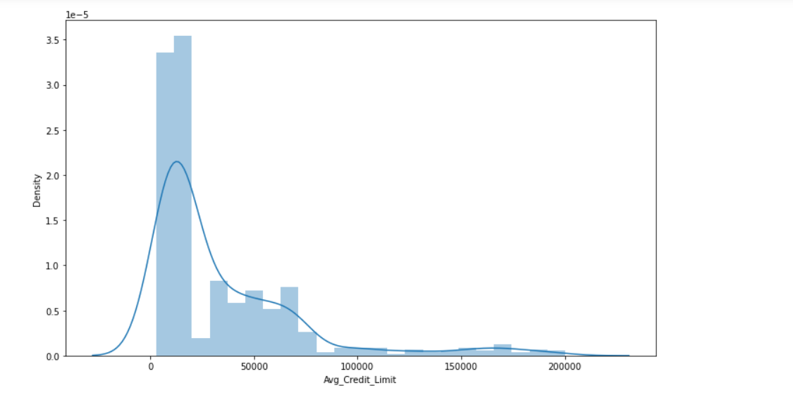
Univariate analysis Average credit limit
Observation: The majority of records do not have credit or have a low limit?
Average Credit Limit is between 10k to 20k and maximum limit of our credit card is 2 lac. And minimum limit of card is 5k.

Slide 7
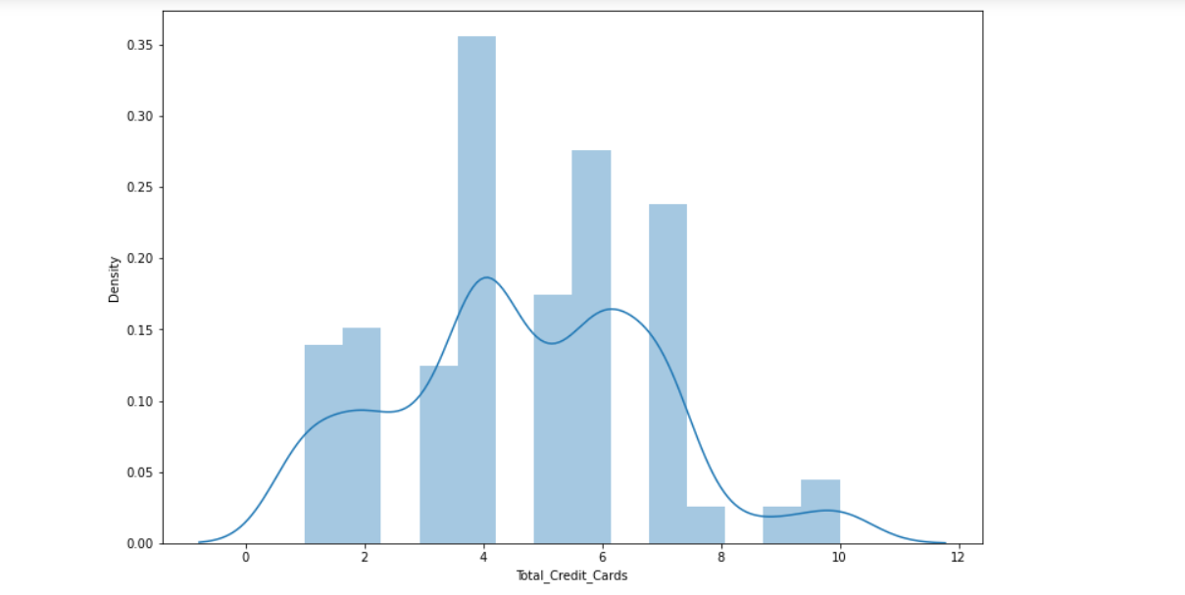
Total credit cards
Observation: . I can't help but wonder, why do some many users have more than one credit card?
Looks to be normally distributed. The average of total_credit_cards are between 4 to 7. and maximum cards are 10. And Minimum Total_Credit_Card we have are 1 to 2.

Slide 8
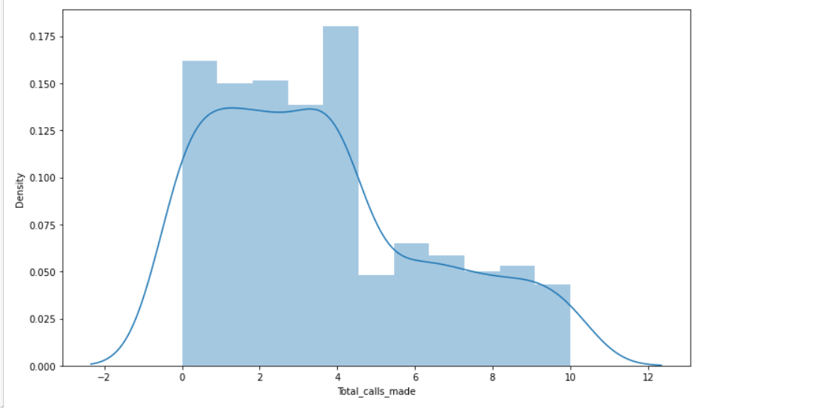
Total calls made
Observation: The total number of calls made by the customer?
Average number of calls made by the customer are between 1 to 5. And maximum number of calls made by the customer are almost 10. And minimum calls made near to 1 to 2.

Slide 9
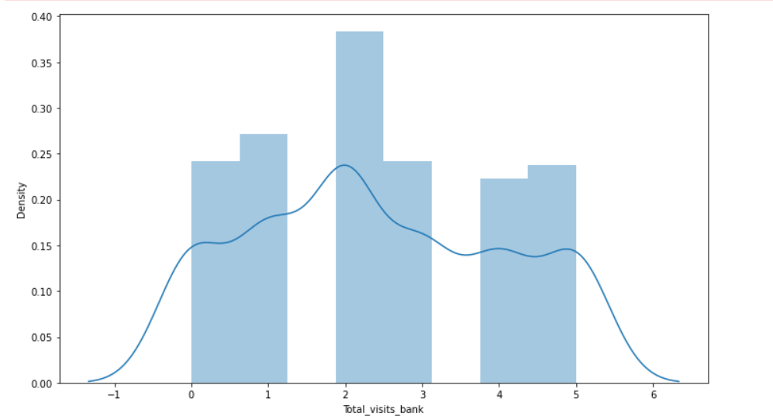
Total bank visits
Observation:
Total number of Visits that customer made (yearly) personally to the bank are?
. Average number of people of visiting bank is between 2 to 4 times. And the maximum number of times customer visited the bank are are 5 times.

Slide 10
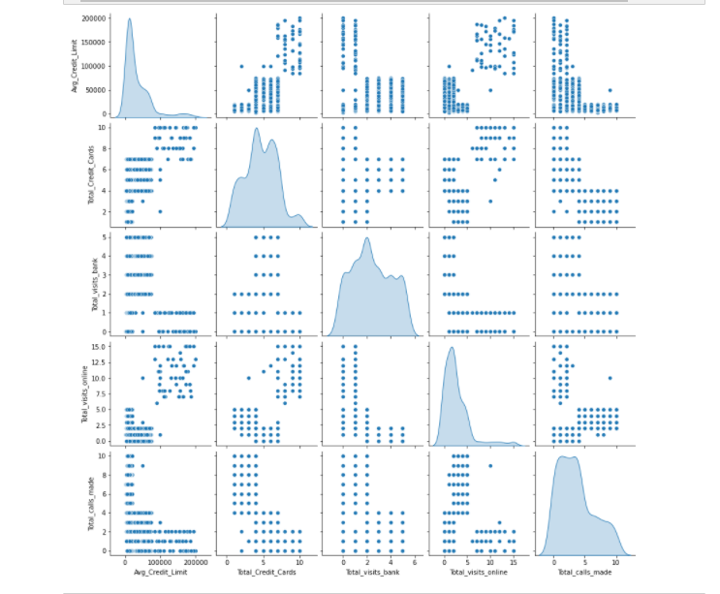
Bivariate Analysis
We use the pair plot for bivariate Analysis.
As in first plot you see the Avg_credit_limit is between 100000 to 150000.
And the avg_credit_card are between 5 to 8.
There are very low number of people who visit bank rather than making calls and online transactions.
Most of the people are sort there issues by making calls.

Slide 11
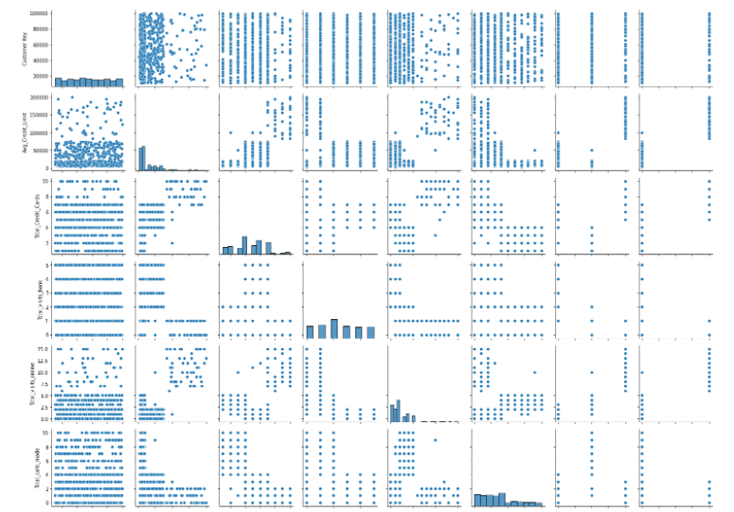
pariGrid plot( Bivariate Analysis)
Note:
Pairgrid plotting is about a Subplot grid for plotting pairwise relationships in a dataset. In this, the class maps each variable in the dataset onto a column and row in a grid of multiple axes.
We are using the PariGrid Plot for bivariate Analysis.
And it tells that Avg_credit_limit is between 25k to 50k.And very few number of customer have their limit up to 2 lac.
And reaming information is almost same as pair plot

Slide 12
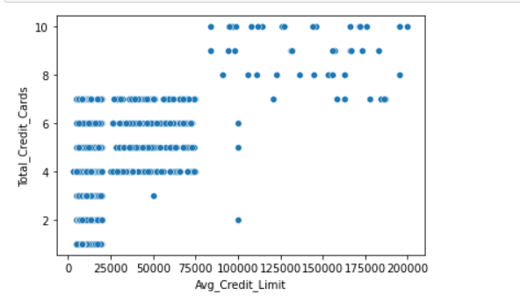
Avg_credit_limit vs Total_Credit_Cards
The customers who have Total_Credit_Cards between 4 to 7 have almost 25k to 75k Credit limit. And maximum number of credit card limit is near to 2 lac. And minimum limit is 25k.

Slide 13
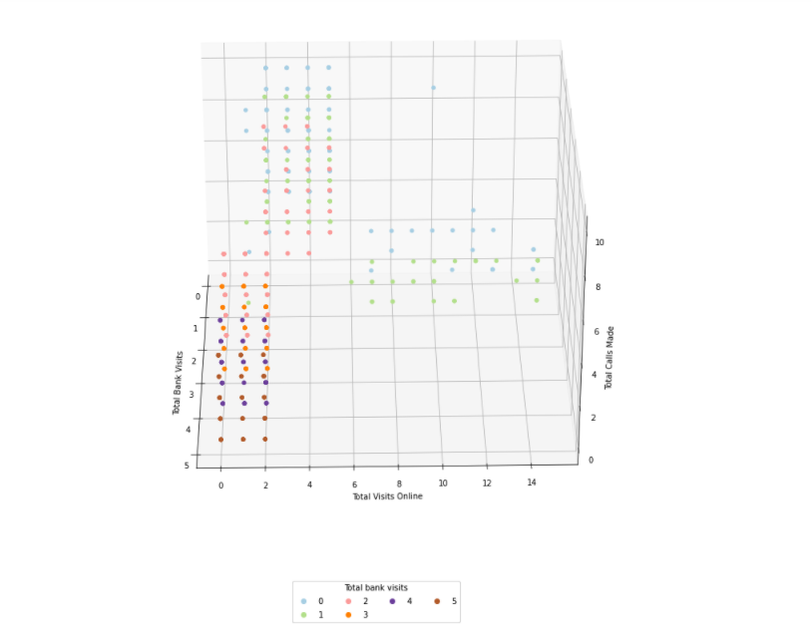
Contact method(3D plotting)
Observation:
Plot 3D scatter plot which shows where customers would stick to their preferred method for interacting with their bank (online, in person, and through the phone)?
A hypothesis that I had going into this was that there would be three clusters for contact method, where customers would stick to their preferred method for interacting with their bank (online, in person, and through the phone). Below we can see a 3D rotating scatter plot which shows my hypothesis was correct.

Slide 14
Section 2
Illustrate the insights based on EDA Key meaningful observations on individual variables and the relationship between variables

Slide 15
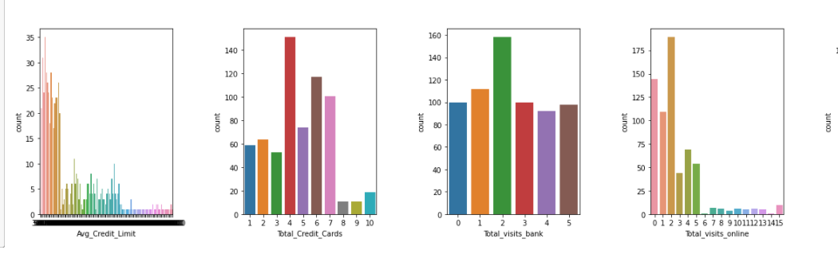
Insights based on EDA
There are 660 observations and 7 columns in the dataset.
All columns have 660 non-null values i.e. there are no missing values.
All columns are of int64 data type.
There are no missing values.
Credit limit average is around 20K with 50% of customers having a credit limit less than 5K, which implies a high positive skewness.

Slide 16
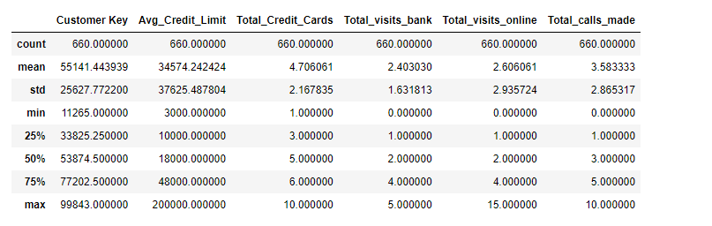
On average, credit cards owned by each customer are ~4. Some customers have 10.
On average, most customer interactions are through calls, then online. Also, some customers never contacted/visited the bank.
Looking at standard deviation, we can see a considerably high variation in credit limits as well.
And in others columns like Total_Credit_Cards, Toal_visits_online and Total_calls_made have very low amount of variations in data.

Slide 17
Continue Insights
Have a higher average credit limit and also seen that each customer have up to 8 to 10 credit cards to the maximum.
Therefore , the number of visits via online is higher but there visits to bank is lower .
The reason most of these customers get a higher income and they the spend more and so they rely more visits online for easier payments.
They seldom do calls or at the most 2 per day.

Slide 18
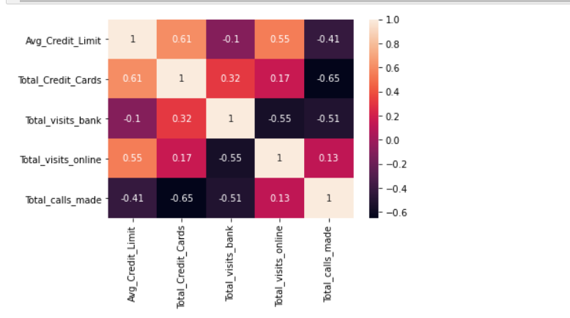
Relationship between variables
Total credit cards and total visit online has medium positive correlation with average credit limit : 0.61,0.55 respectively.
Total credit cards and total visit bank has medium negative correlation with total calls made : -0.65,-0.5 respectively.
Total visit online and medium negative correlation with total visit bank : -0.55.

Slide 19
Section 3 Data Preprocessing
Feature engineering - Missing value treatment - Duplicate observations check

Slide 20

Exploratory data analysis(EDA)
We have a data set of Credit Card Customer Segmentation
This is not a huge dataset so, we will explore the dataset to know more about the data shape, descriptive analyses, Statistical analysis, Univariate ,bivariate analysis, correlation, missing values, dtypes, column names etc.
Let’s try to look the shape of data:

Slide 21
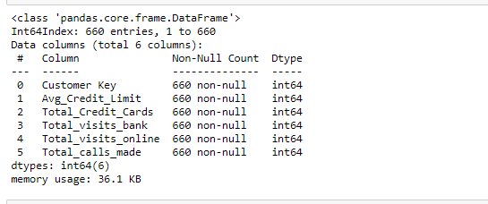
Lets check the column name and information about the data
Now we Exploring the column names is an important aspect of EDA. • We can see that columns are not null. The data types of all columns are integer data type.
By closely observing the data and description given about each column attribute we can say that:
Numeric data columns are Customer Key, Avg_Credit_Limit, Total_Credit_Cards, Total_Visits_bank, Total_calls_made.

Slide 22
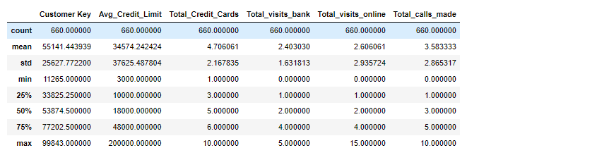
Descriptive Analysis
The Exploratory Data Analysis is more important method which is describe method shows basic statistical characteristics of each numerical feature (int64 and float64 types):
Number of non-missing values, mean, standard deviation, range, median, 0.25 and 0.
We can see the Min, Max, mean and standard deviation for all key attributes of the datase75 quartiles.

Slide 23
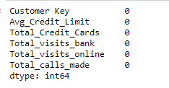
Missing value
There is no missing value in our dataset so we not need to handle that and also all the columns are numeric we not need to apply any label encoding to convert columns into numeric columns.

Slide 24
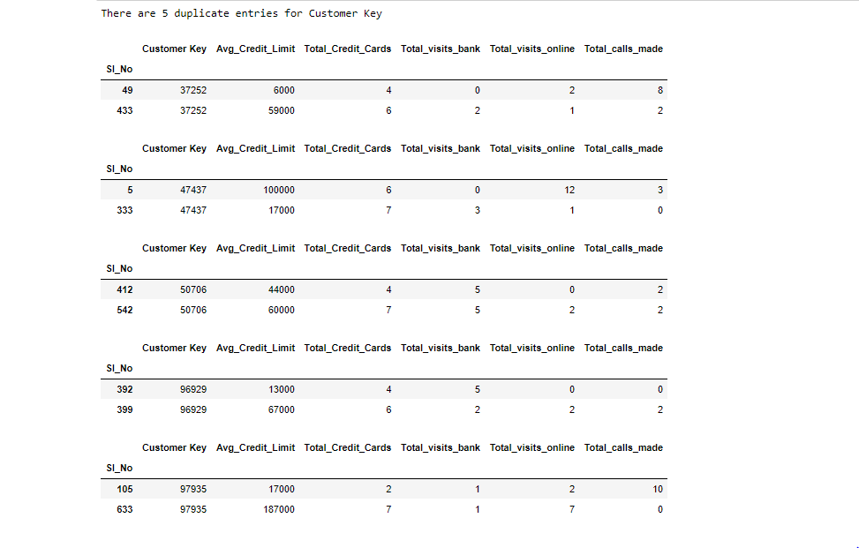
- Duplicate observations check
There are 5 number of duplicate entries for customer key. We handle with this in next. First you see that those are the five values Sl_No which are duplicated.

Slide 25
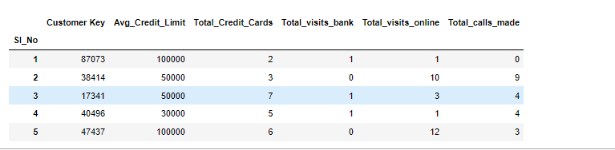
Feature engineering
After feature engineering we achieve that we have only 6 columns and all columns are important.
And by choosing those our model give more accuracy. And those columns are
Customer Key, Avg_Credit_Limit, Total_Credit_Cards, Total_Visits_bank, Total_calls_made

Slide 26
Section 4 Model building
Apply K-means Clustering - Elbow curve - Silhouette Score - Figure out the appropriate number of clusters

Slide 27
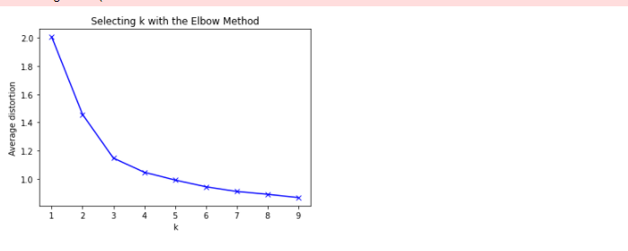
K-Means Clustering
First, we want to iterate through and view the performance of each value of K for K-means, then using a line graph to find the elbow of the plot we can select the optimal number of clusters.
By using Elbow method we identify that there are 3 optimal number of clusters we have to made.

Slide 28

silhouette score
silhouette score is a metric used to calculate the goodness of a clustering technique. Its value ranges from -1 to 1. 1: Means clusters are well apart from each other and clearly distinguished. And here we got 0.51 which means that we are not distinguished our clusters much.

Slide 29
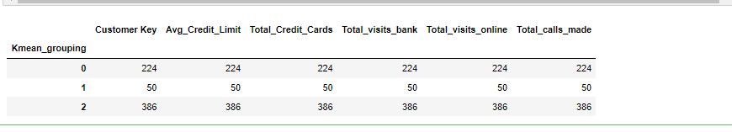
Kmean_grouping
Here we add the predictions to the unscaled data so that we can gain some real world interpretability.

Slide 30
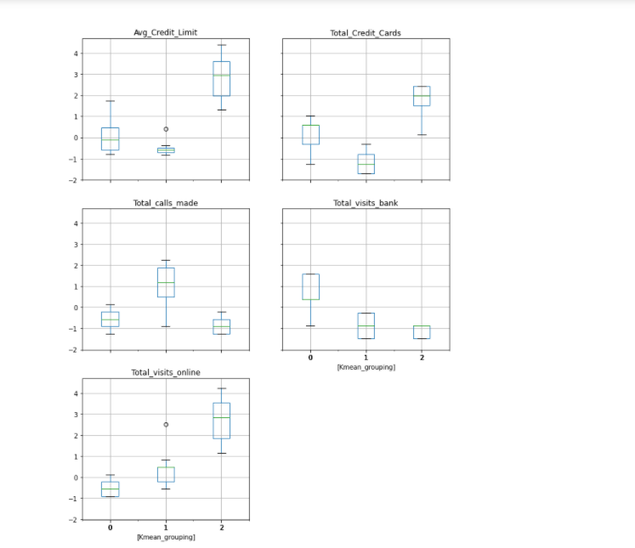
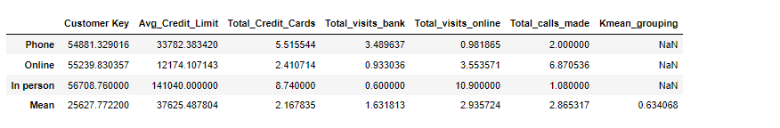
Below we see the average values for each feature in each cluster, the final row of the dataframe is the mean value for each column (since this data is unscaled we can use this to determine how big of a step each of these means is from one another).
It would appear my hypothesis of the clusters forming along query method has proven correct. If we look at the data we see that there is a group which prefers online interactions with their bank, they have a much higher credit limit and also have more credit cards. The customers who prefer in-person interactions tend to have the least number of credit cards and the lowest credit limit. The customers who contact via phone call are in the middle.
One additional observation is that if we tally up the number of interactions per group (how many times they have used online, phone, or in-person services) we see the in-person customers appear to be the most active. This was the opposite of my initial expectations as visiting a bank in person has the highest friction (effort required) to complete

Slide 31
Section 5
Applying Hierarchical clustering - Apply Hierarchical clustering with different linkage methods - Plot dendrograms for each linkage method - Figure out the appropriate number of clusters

Slide 32
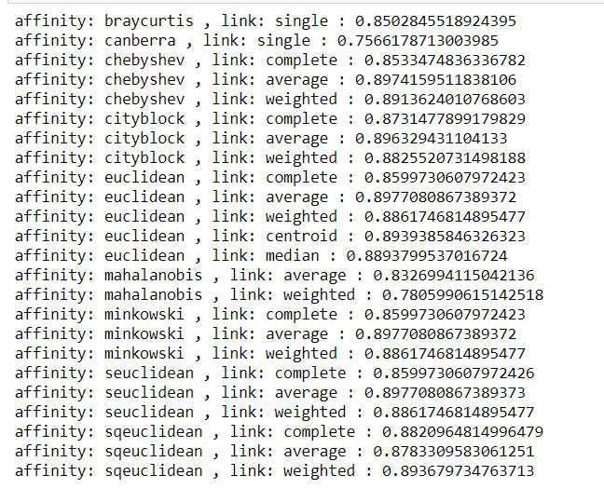
Hierarchical Clustering
For hierarchical clustering, we begin by evaluating the cophenetic coefficients for each linkage type and also each affinity/metric. Below is a list of said outcomes, ignoring any combination that scores poorly, and ignoring any combination that will result in an error. It's worth noting that scipy has more options than sklearn does for metrics and linkages. While there are several good combinations, I will pick Euclidean for the metric and average for linkage as these are options in both scipy and sklearn.

Slide 33
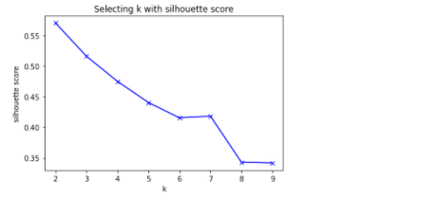
Figure out the appropriate number of clusters
Next, I need to decide on the number of clusters. There are two methods I use here to reach my conclusion, the first plot shows the silhouette score by the number of clusters. Based on this I would not want more than 4 clusters as the score gets too low. The second plot is the dendrogram, which plots the merging of the groups base on distance. The dendrogram shows a long distance (the y axis) for the two final groups and each of the subsequent groups has a drastically shorter distance. This would suggest to me that there are two distinct groups under this method.

Slide 34
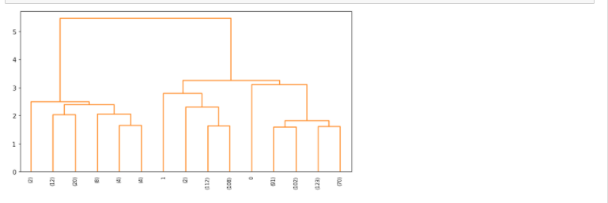
This method resulted in two clusters, with one cluster containing only 8% of the total records. It is also worth noting that the online user segment matches the same online user segment from Kmeans. Interestingly enough this division seems to be the users who prefer internet transactions and those who do not. Once again, online users have more credit cards and a larger credit limit.
Not shown below: when using 3, 4, 5, or 6 clusters, all but two of the clusters have less than five records. Obviously, such clusters don't provide meaningful data.

Slide 35
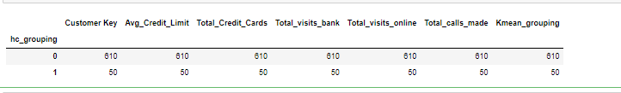
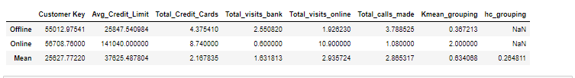
Hierarchical Clustering Grouping
Here we add the predictions to the unscaled data so that we can gain some real world interpretability.
Below we see the average values for each feature in each cluster, the final row of the dataframe is the mean value for each column (since this data is unscaled we can use this to determine how big of a step each of these means is from one another).

Slide 36
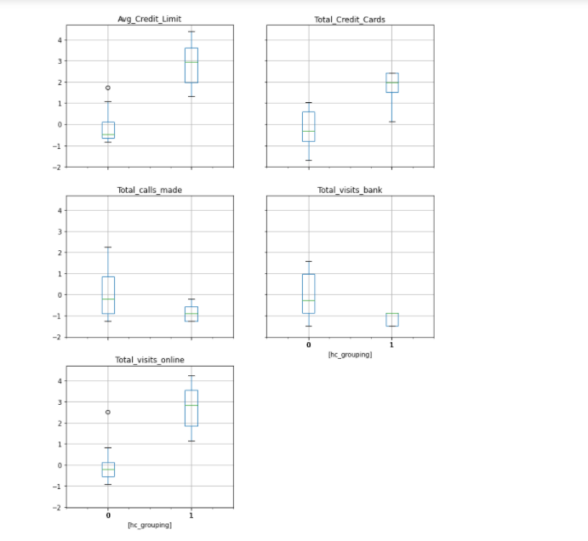
It would appear my hypothesis of the clusters forming along query method has proven correct. If we look at the data we see that there is a group which prefers online interactions with their bank, they have a much higher credit limit and also have more credit cards. The customers who prefer in offline tend to have the least number of credit cards and the lowest credit limit.

Slide 37
Section 6
Compare clusters from K-means and Hierarchical Clustering and perform cluster profiling -List the insights about different clusters.

Slide 38
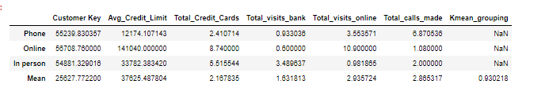
Comparing K-means and Hierarchical Clustering K- means Cluster Profiling
Cluster Profiles:
Group 0:
Customers with minimum credit limits (~ 12K in average).
They also have the least average number of credit cards (~ 2 cards each).
They tend to make phone calls rather than online and bank visits.
Group 1:
Customers with middle credit limits (~ 34K in average).
They also have the middle average number of credit cards(~ 6 cards each).
They tend to visit the bank more often rather than making calls and online transactions.
Group 2:
Customers with maximum credit limits (~ 140K in average).
They also have the maximum average number of credit cards(~ 9 cards each).
They tend to make online transactions rather than phone calls and bank visits.

Slide 39
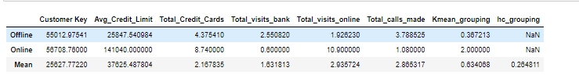
Hierarchical Cluster Profiling
Cluster Profiles:
Group 0:
Customers with minimum credit limits (~ 25K in average).
They also have the least average number of credit cards (~ 4 cards each).
They tend to make phone calls rather than online and bank visits.
Group 1:
Customers with middle credit limits (~ 141K in average).
They also have the middle average number of credit cards(~ 8 cards each).
They tend to visit the bank more often rather than making calls and online transactions.

Slide 40
Insights about different Cluster
Group 1 own less credit card than others, bank should target group 1 to upsell credit cards services.
Besides, bank should provide higher credit limit to target group 0 where most of the customers are. With higher credit limit, group 0 would be able to spend more.
Since group 0 use the online banking the least, bank should promote more to group 0 in order for them to use it.
Assuming group 1 who make most phone calls are the customers perceive the support services of the bank poorly. Bank should target group 1 and provide better customers service by conducting feedback survey through phone.

Slide 41
Key Questions Answer
T here are three distinct categories of customers in AllLife Bank Credit card customer base.
How are these segments different from each other?
In-person users: prefer to handle bank transactions in person. They have the fewest credit cards and the lowest available credit. They are also the most active users.
Phone users: prefer verbally handling transactions remotely.
Online users: prefer digital transactions. They also have the most credit cards and the highest available credit.
What are your recommendations to the bank on how to better market to and service these customers?
We can tailor contact methods to these customer preferences. Online/phone users will probably prefer email/text notifications, while in-person users mail prefer mail notifications and upselling (when at the bank location). Since online users tend to have (and presumably use) the most credit, these may be the demographic we want to target with our next ad campaign, focusing on digit recruiting.

Slide 42
SECTION 7
- Key Insights and Business recommendation

Slide 43
Insights and Recommendations for the Future Business
Insights and Recommendations
Business can offer better phone service to these customers as they are a sizeable percentage of population. Feedback on service delivery can be requested from customers to improve perception of delivery. New customers could be added to this category by offering cards with low credit limit. They can be offered more credit cards as their credit card utilization is low.
Business can offer better in person service to these customers as they are a sizeable percentage of population. They can be offered more information about online banking for some services, keeping their convenience in mind.
Business can look to add more customers in this category, as this cluster is a small percentage of the customers population.

Slide 44
Business can contact these customers to offer credit cards or to get feedback about service.
We can tailor contact methods to these customer preferences. Online/phone users will probably prefer email/text notifications, while in-person users mail prefer mail notifications and upselling (when at the bank location). Since online users tend to have (and presumably use) the most credit, these may be the demographic we want to target with our next ad campaign, focusing on digit recruiting.

